Slide 1
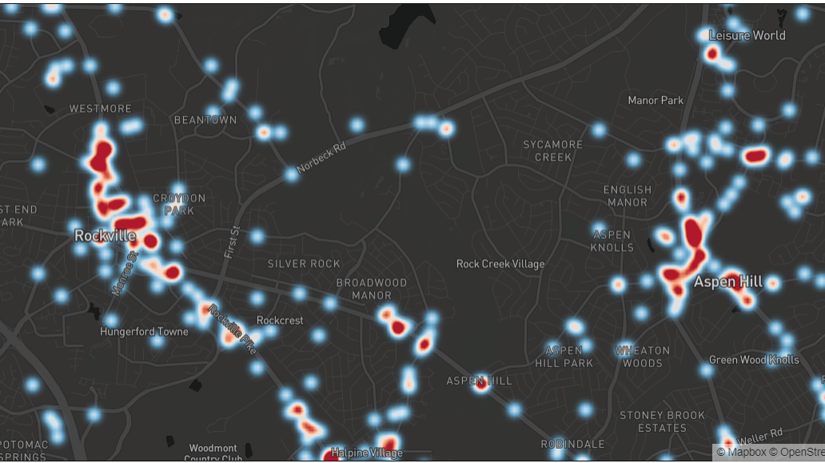
A Review for Traffic Safety in Montgomery County, MD - Vehicle Collisions Data Visualization and Analysis
Yanmin lu
Deliverable 2
Data 606 Fall 2020

Slide 2
EDA Pre-processing
Deal with missing values
Merge three datasets into one fatal dataset
Use function to group values, e.g., Weather, Crash Time
Change categorical data to numerical type
Notes:
for those “UNKNOWN”values, are imputed by the most relevant/frequent value of the column;

Slide 3

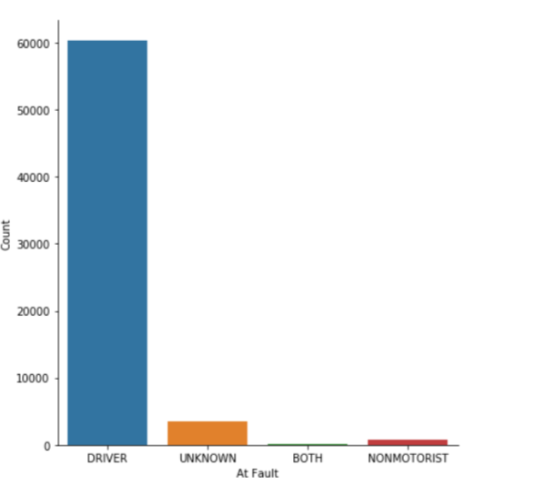
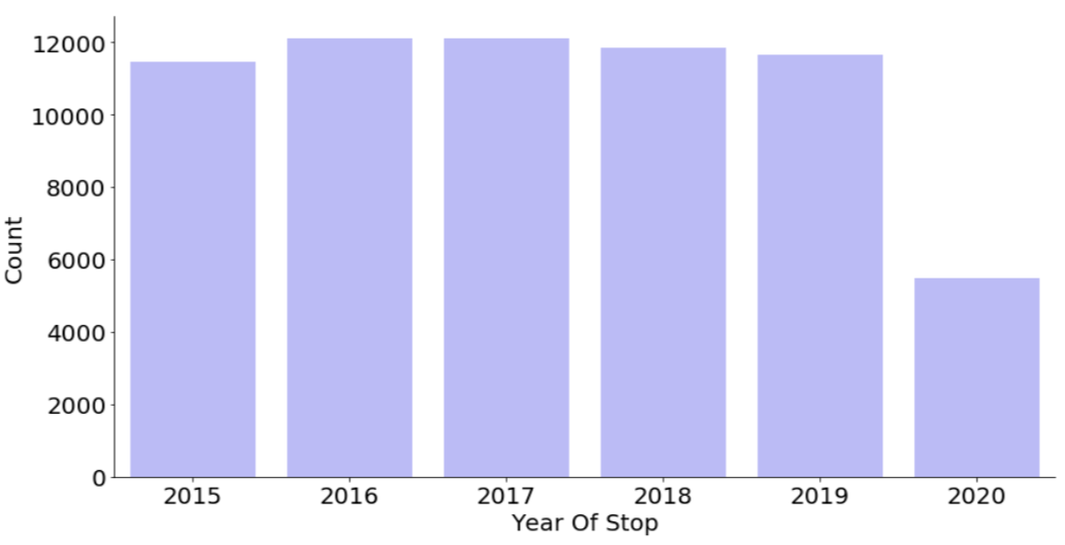
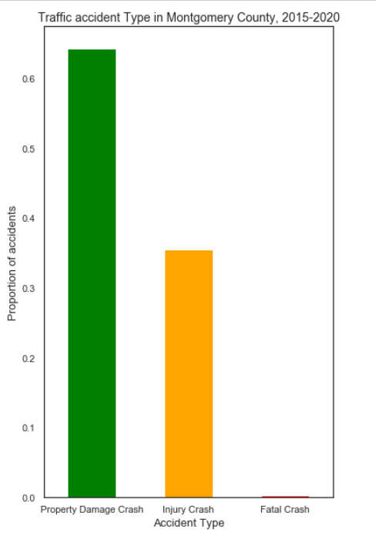
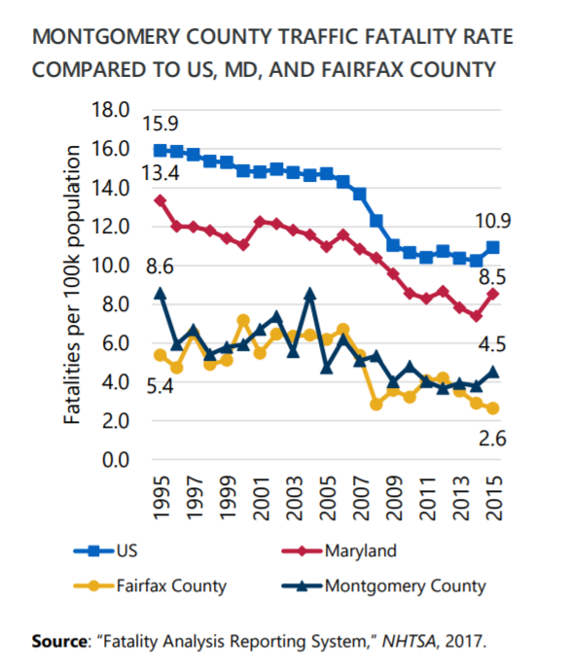
During 2015 to 2020, Montgomery County averages:
over 10,000 vehicle incidents every year;
Total 164 fatalities, averages around 30 per year;
Most cases are “Property Damage Crash(64.24%);
More than 90% of the incidents were at fault by Drivers.

Slide 4
EDA Results and Discussions
Severity & Victim Analysis
Time Factors
Cause & Vehicle analysis
Weather & Light condition

Slide 5

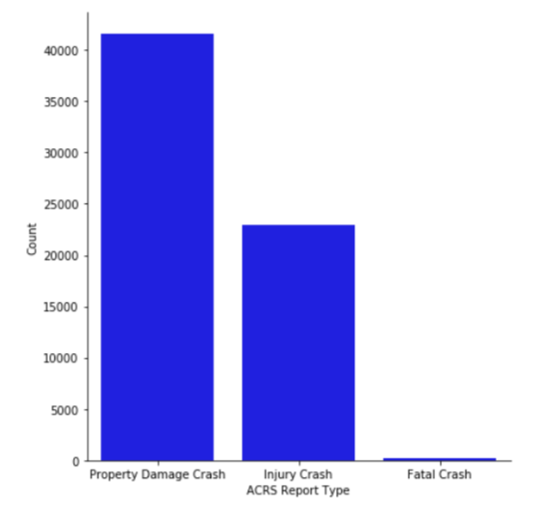


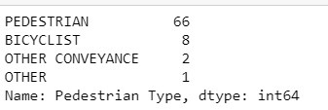

Severity & Victim Analysis
“Fatal” collisions are rarely seen(0.27%).
174 fatal collisions involved 247 drivers and 77 non-motorists.
Pedestrians consist of a significant portion of the non-motorist collision victims. The number is significantly higher than that of bicyclists.

Slide 6
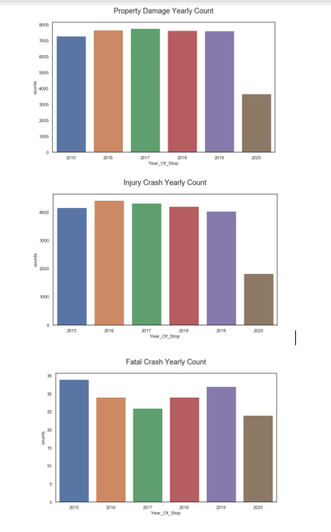
Time Factors
The total incidents counts show a relevant flat trend, including year count and monthly count.
However, the fatal crashes counts have some fluctuating trends.

Slide 7
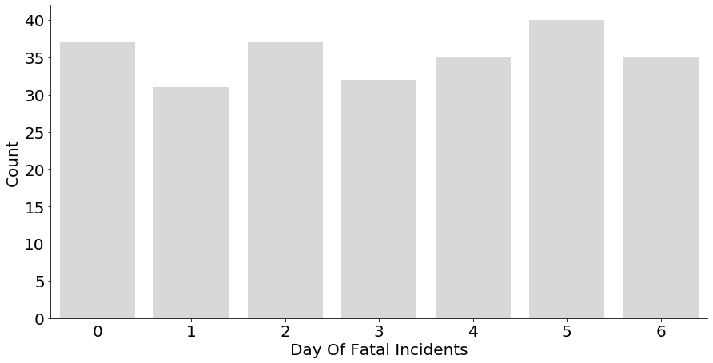
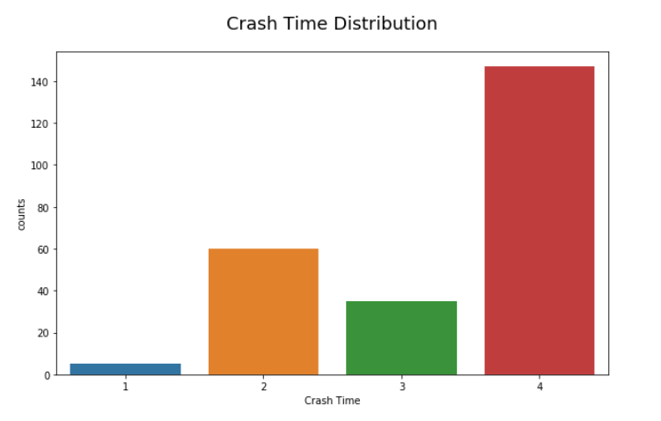
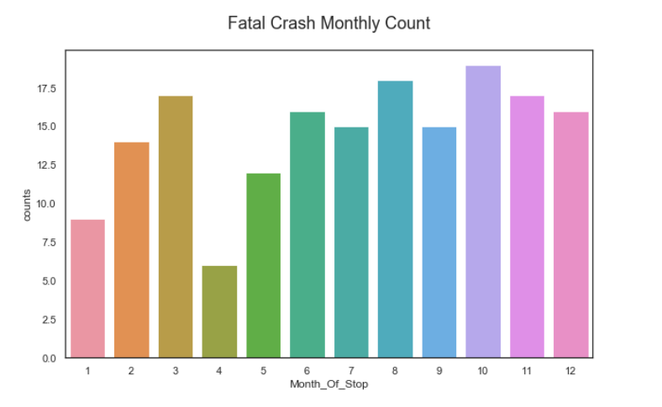
Time Factors
The most fatal crashes occurred in October, the least amount in April.
The highest number of fatal crashes occurred on Saturdays, the least on Tuesdays.
The most fatal crashes occurred from 7:00 p.m. – 7:00 a.m. (147 crashes), the least fatal amount of crashes occurred from 7:00 a.m. – 9:00 a.m. (5 crashes)

Slide 8
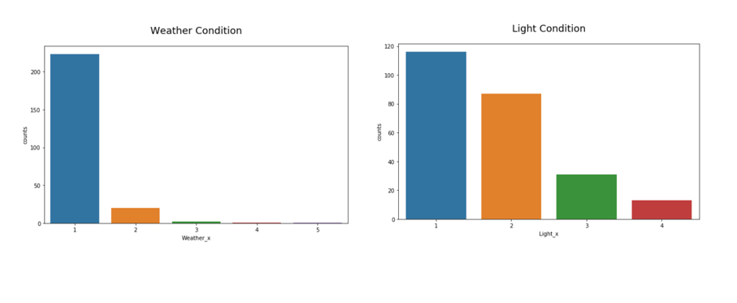
Conditions analysis

Slide 9
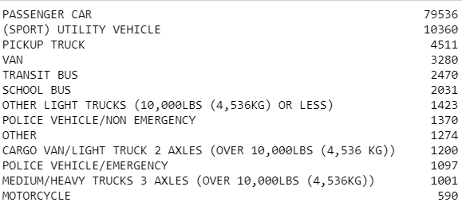
Causes & Vehicle analysis
Collision Types
Top involved types of vehicles
Single vehicle
Straight Movement Angle
Head On
Head On Left Turn
Same Dir Rear End
Same Dir Rend Right Turn
Same Direction Left Turn
Angle Meets Left Head On
Notes:
This dataset provides general information about each collision and details of all traffic collisions occurring on county and local roadways within Montgomery County, as collected via the Automated Crash Reporting System (ACRS) of the Maryland State Police, and reported by the Montgomery County Police, Gaithersburg Police, Rockville Police, or the Maryland-National Capital Park Police. Please note that these collision reports are based on preliminary information supplied to the Police Department by the reporting parties. Therefore, the collision data available on this web page may reflect: -Information not yet verified by further investigation -Information that may include verified and unverified collision data -Preliminary collision classifications may be changed at a later date based upon further investigation -Information may include mechanical or human error This dataset can be joined with the other 2 Crash Reporting datasets (see URLs below) by the State Report Number. * Crash Reporting - Drivers Data at https://data.montgomerycountymd.gov/Public-Safety/Crash-Reporting-Drivers-Data/mmzv-x632 * Crash Reporting - Non-Motorists Data at https://data.montgomerycountymd.gov/Public-Safety/Crash-Reporting-Non-Motorists-Data/n7fk-dce5 Update Frequency : Weekly
This dataset provides general information about each collision and details of all traffic collisions occurring on county and local roadways within Montgomery County, as collected via the Automated Crash Reporting System (ACRS) of the Maryland State Police, and reported by the Montgomery County Police, Gaithersburg Police, Rockville Police, or the Maryland-National Capital Park Police. Please note that these collision reports are based on preliminary information supplied to the Police Department by the reporting parties. Therefore, the collision data available on this web page may reflect: -Information not yet verified by further investigation -Information that may include verified and unverified collision data -Preliminary collision classifications may be changed at a later date based upon further investigation -Information may include mechanical or human error This dataset can be joined with the other 2 Crash Reporting datasets (see URLs below) by the State Report Number. * Crash Reporting - Drivers Data at https://data.montgomerycountymd.gov/Public-Safety/Crash-Reporting-Drivers-Data/mmzv-x632 * Crash Reporting - Non-Motorists Data at https://data.montgomerycountymd.gov/Public-Safety/Crash-Reporting-Non-Motorists-Data/n7fk-dce5 Update Frequency : Weekly

Slide 10
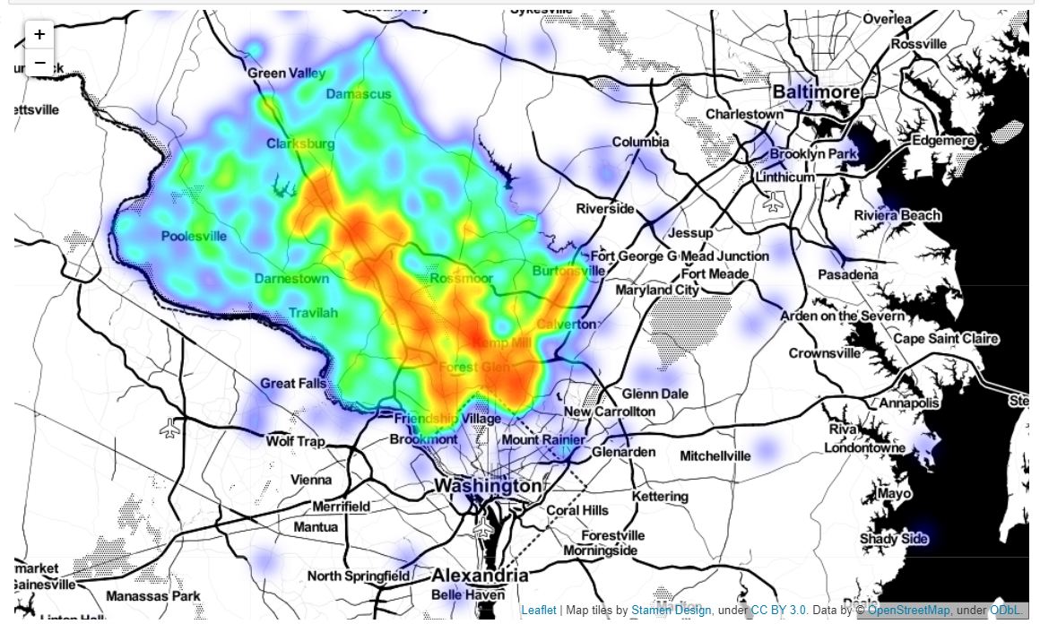
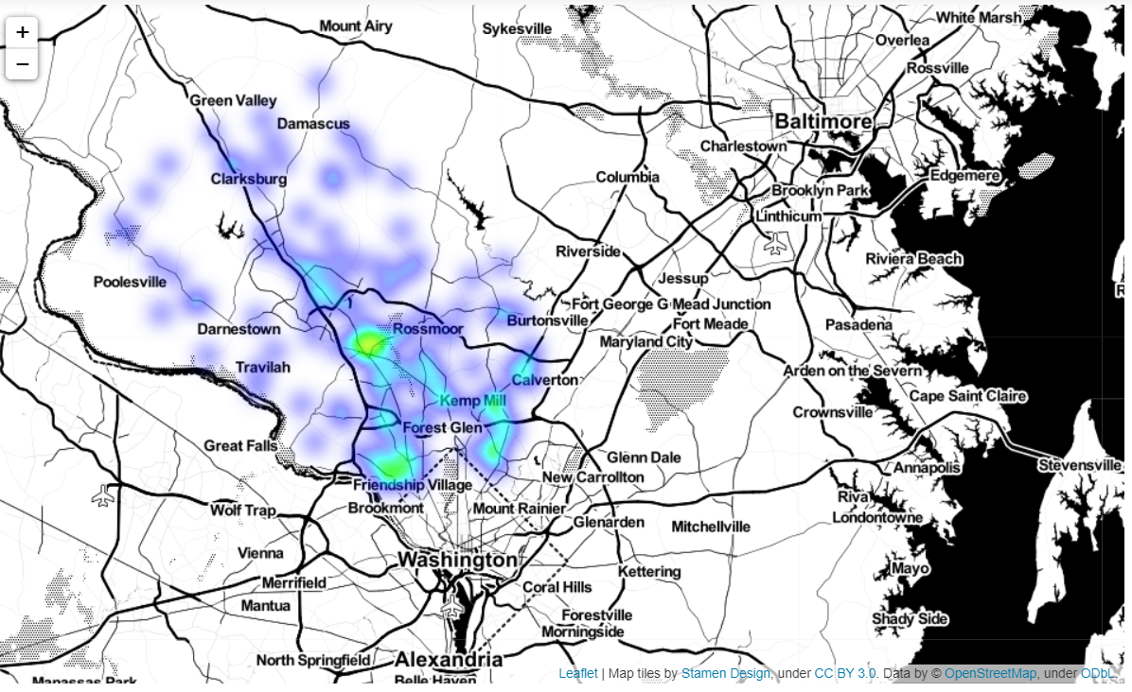
Crashes on Heatmap
Incidents Map
Fatal Crash Map
The Most Fatal Crashes happened:
Montrose Parkway/East Jefferson Street (11)
I 495/Connecticut Avenue (6)

Slide 11

Brief Introduction of the Model
Logistic Regression
Random Forest
SVM
Notes:
RFE(Recursive Feature Elimination): Recursively eliminates the features which does not in target variable values
SelectKBest: provides the k best features by performing various statistical tests i.e., chi squared computation between two non-negative features

Slide 12
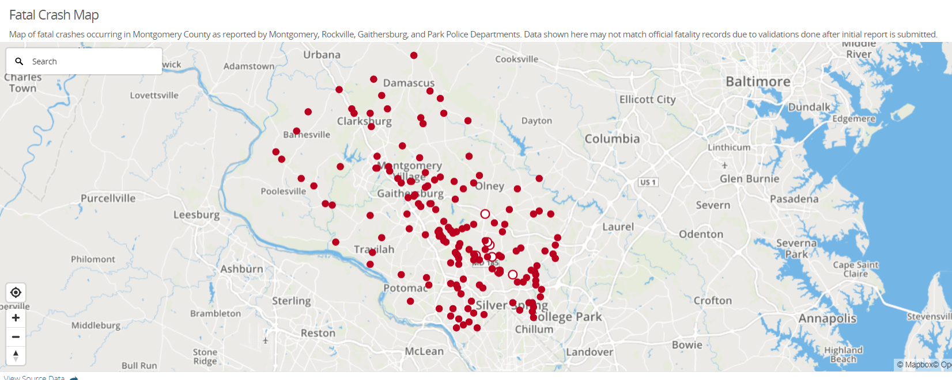
Link to my repository
https://github.com/ylu2md/ds606

